Slide 1
Software Quality Assurance and Testing
Lecture - 07
Harish Aggarwal

Slide 2
Test Execution and Automated Testing

Slide 3
Re-Cap
Lecture - 01
Definitions – S/W Quality, S/W Quality Assurance
Importance of QA
Causes of Defects
Business Models in S/W
S/W Cost, Quality Cost
Quality culture
Lecture - 02
Software Quality Models
McCall, IEEE 1061, ISO 25000 Series
Quality Requirements
Quality of Requirements
Frameworks
ISO/IEC/IEEE 12207 - Software Life Cycle Processes
Lecture - 03
Frameworks
CMMI-Development
ITIL Framework
Other Frameworks
Lecture - 04
ISO 25010 – Quality Attributes
Functional Suitability, Performance Efficiency, Compatibility, Usability, Reliability, Security, Maintainability, Portability
Lecture - 05
Software Testing Fundamentals
Software Verification and Validation
Types of Testing - Black Box, White Box Testing
Test Levels and Types –
Unit, Integration, System Testing

Slide 4
Re-Cap
Lecture - 06
Test Design Techniques
Combinatorial Testing
Boundary Value Analysis
Equivalence Class Partitioning

Slide 5
Agenda
Test Methodology – Decision Table Testing
Test Execution Process
Test Case Design
Automated Testing
Alpha and Beta Site Testing Programs
Regression Testing Strategies

Slide 6
Decision Tables
One of the most systematic approaches of designing Test Cases
Decision Tables are rigorous – enforce logical rigor
Related Method – Cause Effect Graphing
Ideal for situations with number of combinations of actions are taken under varying sets of condition
Structure of describing rules
Steps
Specifications
Decision Table
Test Cases

Slide 7
Black Box Testing
Decision Table Based Testing
A column in the entry portion is a rule.
Rules indicate which actions are taken for the conditional circumstances indicated in the condition portion of the rule.
Decision tables in which all conditions are binary are called limited entry decision tables.
If conditions are allowed to have several values, the resulting tables are called extended entry decision tables.
To identify test cases with decision tables, we follow certain steps:
Step 1. For a module identify input conditions (causes) and action (effect).
Step 2. Develop a cause-effect graph.
Step 3. Transform this cause-effect graph, so obtained in step 2 to a decision table.
Step 4. Convert decision table rules to test cases. Each column of the decision table represents a test case. That is,
Number of Test Cases = Number of Rules
n conditions exist, there must be 2^{n} rules.

Slide 8
DT - Example
Component Specification: Input of 2 characters such that
The 1st character must be A or B.
The 2nd character must be a digit.
If the 1st character is A or B and the 2nd character is a digit the file is updated.
If the 1st character is incorrect, message X12 is displayed.
If the 2nd character is not a digit, message X13 is displayed.
Develop test cases using Decision table technique

Slide 9
DT Example Solution
Note that it may not be possible to execute or even design test cases for the impossible action rule. But to begin with never ignore these conditions. Design them and then evaluate if they can be included in the Test Suite.

Slide 10
Black Box Testing
Decision Table Based Testing
Next Date is a function of three variables: month, date, and year. It returns the date of next day as output. It reads current date as input date.
M1 = {month: month has 30 days}
M2 = {month: month has 31 days except December}
M3 = {month: month is December}
M4 = {month: month is February}
D1 = {day: 1 ≤ day ≤ 27}
D2 = {day: day = 28}
D3 = {day: day = 29}
D4 = {day: day = 30}
D5 = {day: day = 31}
Y1 = {year: year is a leap year}
Y2 = {year is a common year}

Slide 11
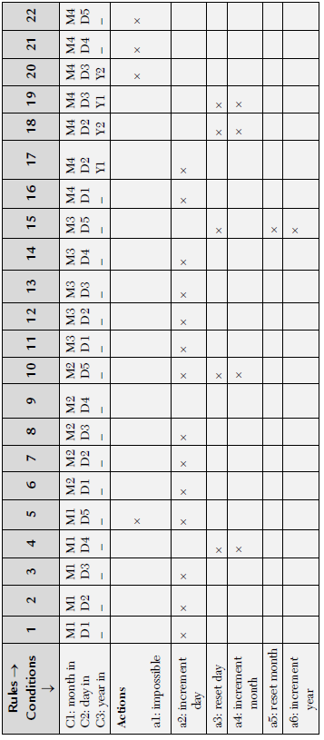
Black Box Testing
Decision Table Based Testing

Slide 12
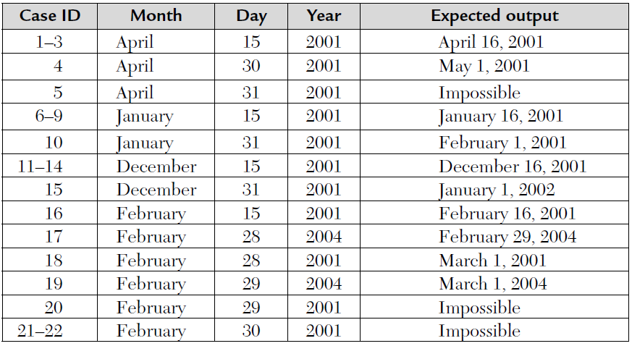
Black Box Testing
Decision Table Based Testing

Slide 13
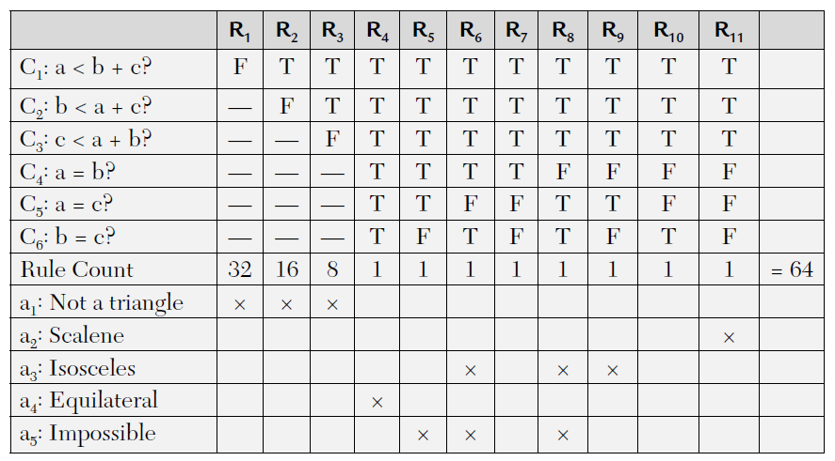
Decision Table – Triangle problem
Ref: – Software Testing by Rajiv Chopra

Slide 14
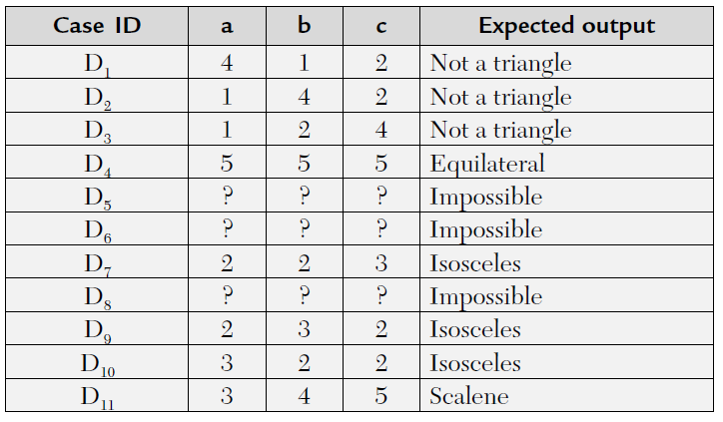
Decision Table – Triangle problem
Ref: – Software Testing by Rajiv Chopra

Slide 15
Software Test Execution
Goal -
Design Test Cases which cover vast area of Software thoroughly and accurately
Less number of Test Cases
Improved Quality
Testing Phases
Determine Test Methodology.
Planning Tests
Designing Tests
Performing the Tests

Slide 16
Software Test Strategy
Decision to be made in Test Strategy -
Approach – Top-Down, Bottom-Up, Sandwich, Big-Bang
Which parts should be tested with White-Box Model
Which parts should be tested with Black-Box Model
How much and which area to be covered by Automated Tests
Planning Tests
Unit Tests
Integrations Tests
System Tests

Slide 17
Software Test Strategy
What to Test.
Avoid duplication in case of reused software.
Criticality of the area.
Newer versions of stable software. Added modules/feature.
Who performs the Tests
Unit Test – Development Team
System Tests – Independent Test Team (Internal or External).
Where to Perform Tests
Unit Test or Integrations Tests – Development Site
System tests – Development Site or Consultant Site or Customer Site.
How much to Tests
When all the Tests in Test plan are executed and no issues are found.
Achieve certain minimum level of Error discovery rate.
Resources have ended – Time Limit, Budget.

Slide 18
Software Test Design
Test Design
Scope of the Test
Software Package, module to be Tested.
Testing Environment
Testing Site
Hardware and firmware configuration
Test Details
Test Case ID
Objective
Design Doc reference or requirement doc, if any
Test level – Unit, integration, System
Pre-requisites
Data to be recorded.
Steps for execution

Slide 19
Test Prioritization
Test cases can be prioritized.
Priority setting can be based on
Type of product
Organization size/culture
Resources available
Sample Prioritization
P0 – Tests that need to pass before full testing is started
P1 - This test must be executed before final delivery.
P2 - If time permits, execute this test.
P3 - This test can wait after the delivery date.

Slide 20
Software Test Execution
Test execution Process
Execute Test cases → Find Defects → Fix Defects → Re-Test
Re-Test is called as regression Testing
To find if the Defect fixed is properly fixed
To find if no new Defects is created while fixing the old Defect
Regression Testing can be execution of full Test suit or its subset.
Results of every Test Run are recorded in Software Test Report (STR)

Slide 21
Software Test Report
Test Identification
Tested software Identification – Version, Build, etc
Initiation Time, Concluding time, etc
Test Site
Test Environment – H/W, firmware configuration
Test Results
Test case ID
Test result – Pass/Failed
Summary Results
Total Test case executed.
Total Pass/Fail
Comparison with previous results

Slide 22
Automated Testing
Why Automated Testing
Cost savings
Shortened test duration
Thoroughness
Test accuracy
Automated result reporting
Statistical processing and subsequent reporting of Results
Process of Automated Testing
Just like Manual Testing, it requires –
Test planning, Test design, Test case preparation
Test Execution, Regression testing
Final Test log and report preparation including comparison reports

Slide 23
Types of Automated Testing
Types of Automated Tests
Code Auditing
Check compliance with respect to coding standards.
Code complexity metrics (McCabe’s cyclomatic complexity)
Levels of loop nesting
Levels of subroutine nesting
Prohibited constructs, such as GOTO
Check for Naming conventions for variables, files, etc.
Unreachable code lines of program or entire subroutines.
Format and size of comments
Coverage monitoring
Line coverage achieved when implementing a given test case file.
Path Coverage achieved while the Tests are executed

Slide 24
Types of Automated Testing
Functional Tests
Test Scripts are prepared which emulate the manual Tests
Test automation tools can be used to execute tests
Input data is picked up from Test DB Files.
Executing same test case with different input is easy.
Executing regression testing is easy.
Load Tests
Creating Load Test scenario manually is impactable/impossible.
Can be done through simulations
Load is varied and response plotted in the form of a graph to see system behavior
System response Vs Environment configuration (Hardware and communication)

Slide 25
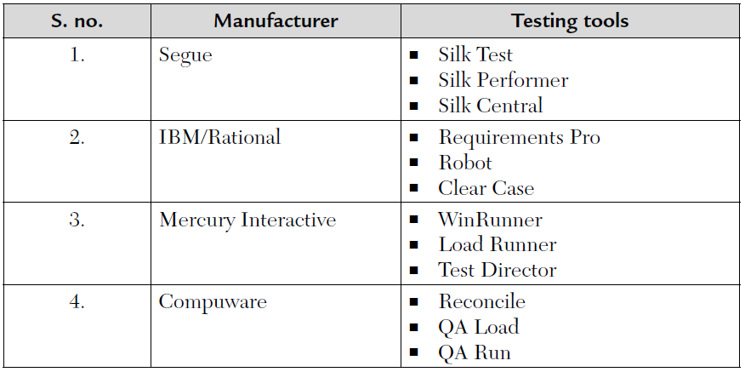
Test Automation Tools

Slide 26
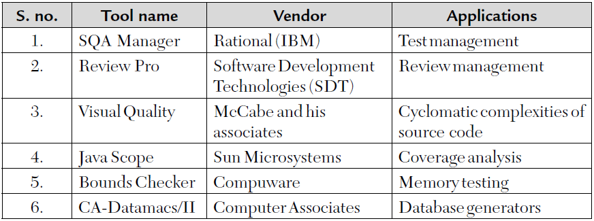
Test Automation Tools

Slide 27
Automated Test Management
Features of Automated Test Management
Test plans, Test results and correction follow-up.
Preparation of lists, tables and visual presentations of test plans
Listing of test case
Execution of automated software tests
Listing of test results
Listing of detected errors
Listing of correction schedule
Listing of uncompleted corrections for follow-up
Correction and Regression tests
Summary reports of testing and error correction follow-up
Summary reports for maintenance correction schedule

Slide 28
Automated Testing
Advantages Vs Disadvantages
S. No. | Advantages | Disadvantages
1 | Accuracy and completeness of Test Execution | High investments required in package purchasing and training
2 | Accuracy of results log and summary reports | High package development investment costs
3 | Comprehensive information | High manpower resources for test preparation
4 | Few manpower resources for test execution | Considerable testing areas left uncovered
5 | Shorter testing periods
6 | Performance of complete regression tests
7 | Performance of test classes beyond the scope of manual testing

Slide 29
Automated Testing
Automation testing is not a 100% replacement for Manual Testing
Does not work when the product itself is changing.
Works well in regression Testing
Test automation takes lots of efforts.
Maintenance cost of automated test cases is very high.
Resource Cost is high for Test Automation Engineers.
Trained resources are needed for Automated Test design, execution and maintenance.

Slide 30
Alpha and Beta Testing
Not same as customer’s acceptance Testing
Alpha Sites - Software is put into real usage among some of the teams in the organization
E.g. Office getting deployed on Development team, HR team machines.
Preparation of lists, tables and visual presentations of test plans
Beta Sites –
Bugs found in formal Testing and alpha sites are already fixed.
Product is close to final product with very few known bugs
Product is ready to be used by customers
Before releasing to all the customers, product is given to select few customers called as Beta Sites

Slide 31
Alpha and Beta Testing
S. No. | Advantages | Disadvantages
1 | Identification of unexpected errors | A lack of systematic testing
2 | A wider population in search of errors | Low quality error reports. Repro not always available
3 | Low costs | Difficult to reproduce the test environment
4 | Real life data and scenarios can be tested | Much effort is required to examine reports
5 | Users perspective known | Loss of real data on users machines

Slide 32
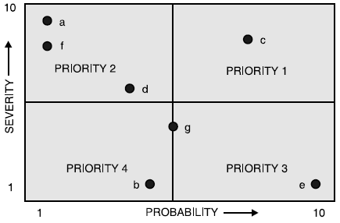
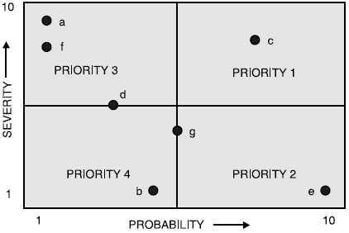
Defect Prioritization
Defects can be prioritized based on severity and probability of occurrence
Fixing of defects by development team is based on defect priority.

Slide 33
Defect Prioritization
Defects that unblock the Testing are given high priority and fixed early
Example Priority and Severity
High Severity, Low priority
Incorrect Logo.
High priority, Low Severity
Slow response to transaction.
No functionality break but an irritant to Test team
Hampers the productivity of Test team
High priority, High Severity
Data corruption issues
Low priority, Low Severity
Incorrect Message on Pop-Up

Slide 34
Regression Testing
Regression Testing is done to ensure that everything is working perfectly which was previously working.
Regression testing is done after enhancements or Defect fixes.
S. No. | Normal testing | Regression testing
1 | It is usually done during fourth phase of SDLC. | It is done during the maintenance phase.
2 | It is basically software’s verification and validation. | It is also called program revalidation.
3 | New test suites are used to test our code. | Both old and new test cases can be used for testing.
4 | It is done on the original software. | It is done on modified software.
5 | It is cheaper. | It is a costlier test plan.

Slide 35
Types of Regression Testing
Types of Regression Testing
Corrective regression testing – No change in specification. Same Test Suit
Progressive regression testing – Change in specification. Modified Test Suit.
Retest-all regression testing – Full Re-Test
Selective regression testing – Test only the impacted and dependent areas.
Regression Testing can be done at
Unit level, Integration level, System Level
Criteria to decide when to stop regression testing.
Time constraints
Test criticality
Customer requirements

Slide 36
Source Code Analyzers
Source code analysis tools, also known as Static Code Analyzers.
No execution of program. Just static code analysis.
To ensure code is compliant with a predefined set of rules or best practices.
Static analysis is generally good at finding coding issues such as
Programming errors
Coding standard violations
Undefined values
Syntax violations
Security vulnerabilities

Slide 37
Source Code Analyzers
Advantages
Speed
Depth
Accuracy
Disadvantages
False Positives

Slide 38
Software Composition Tools
Software composition analysis (SCA) is an automated process that identifies the open source software in a codebase. This analysis is performed to evaluate security, license compliance, and code quality.
It identifies all open source packages in an application and all the known vulnerabilities of those packages
Create an accurate Bill of Materials (BOM) - components included, the version of the components used, and the license types for each.
Discover and track all open source - Uncover all open source used in source code, binaries, containers, build dependencies, subcomponents.
Set and enforce policies – Ensure OSS license compliance.
Enable proactive and continuous monitoring

Slide 39
Thank You

